Slide 1
Exploration and visualisation data
I’roful Bariyah
17.51.0004

Slide 2
Studi Kasus Kali ini menggunakan data “Bank” dengan menggunakan Tools Power Pivot in Microsoft Excel
Data dapat diunduh melalui : https://github.com/ekayuniar/StudiKasus_BI/blob/master/bank1.xls

Slide 3
01
Jumlah Umur
04
Jumlah Total relation count and jumlah months on book
02
Jumlah Income Category
05
Total revolving bal, tot trans ct, tot trans amt,tot ct chngQ4 Q1
03
Jumlah Card Category
Visualisasi Jumlah umur Berdasarkan gender
Visualisasi jumlah total relation count and jumlah mounths on book berdasarkan education level
Visualisasi jumlah income category berdasarkan education level
Visualisasi total Revolving bal, total trans ct, total trans amt, total ct change Q4 Q1
Visualisasi jumlah card category berdasarkan martial status and income category

Slide 4
Jalankan Project

Slide 5
01
Jumlah Umur
Visualisasi Jumlah umur Berdasarkan gender

Slide 6
Jumlah Umur

Slide 7
02
Jumlah Income Category
Visualisasi jumlah income category berdasarkan education level

Slide 8
Jumlah Income Category

Slide 9
03
Jumlah Card Category
Visualisasi jumlah card category berdasarkan martial status and income category

Slide 10
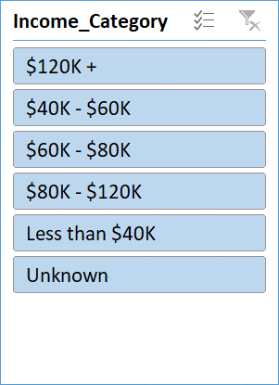
Jumlah Card Category

Slide 11
04
Jumlah Total relation count and jumlah months on book
Visualisasi jumlah total relation count and jumlah mounths on book berdasarkan education level

Slide 12
Jumlah Total relation count and jumlah months on book

Slide 13
05
Total revolving bal, tot trans ct, tot trans amt,tot ct chng Q4 Q1
Visualisasi total Revolving bal, total trans ct, total trans amt, total ct change Q4 Q1

Slide 14
Total revolving bal, tot trans ct, tot trans amt,tot ct chng Q4 Q1

Slide 15
THANKS!
Do you have any questions?
Iraful.bariyah26@gmail.com

